Slide 1
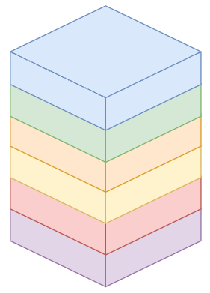
SCRUM METHODOLOGY
Product Backlog
Customer requirements to the product
Prioritized requirements
Managed by product owner
Sprint Backlog
Defined, measurable and verifiable stories
Team commitment
Elaborated by the team and the product owner
Daily Meeting
What was done yesterday?
What will be done today?
What impediments exist?
Meeting
Daily
24 Hr
SPRINT
2 Weeks
Stories with acceptance criteria
Delivery
Nro 3
Delivery
Nro 2
Delivery
Nro 1
Delivery
Sprint Planning
Product Backlog Review
Decomposition into stories with acceptance criteria
Effort estimation
Sprint Retrospective
What was done well during the last Sprint
What can be done better for the following Sprints
Sprint Review
Work completed during the Sprint
Product Demonstration
Product improvement opportunities

Slide 2
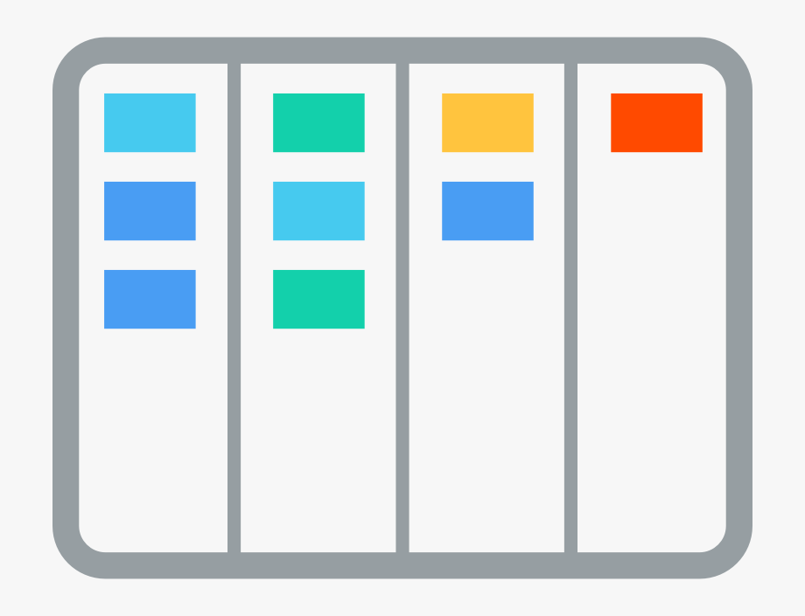
HOW WE DO IT
UX/UI Design
User Persona and Customer Journey
Co-design and iterativity
Low and high fidelity prototyping on Figma, Mobile or Web
Software Engineering
Cloud First. Concurrency, Stateless, Resilience, Elasticity.
Patterns. Microservices, REST, MVC, OAuth2
Industry conventions/standards.
Continuous User Verification
Access to the actual product in short cycles
Early feedback and identification of opportunities
Productive start-up in short timeframes
Analysis
Functional
Design
UI/UX
Development Cycle
Unit and end-to-end test automation
DevOps techniques throughout the process
In-process code quality and safety control
SW Engineering
Revision
Code
and Tests
Scrum
Kanban
Stories
Boards
Stories / Tasks
Code
Development / Test
Cases Tests
Backlog
Integration
Continua
Continuous Delivery
Our design, architecture and techniques allow us to continuously deliver a functional product.
We deploy in the Cloud or on the customer's infrastructure.
Reportes
de Control

Slide 3
CUSTOMIZED SOFTWARE
To consolidate your competitive difference, we build unique, scalable and innovative software solutions. We perform immersive processes to enhance the value of custom software.
E
A
O
I
REMOVE
ACCELERE
OPTIMIZE
INNOVE
Remove the constraint imposed by canned software solutions. Focus on what generates value to your business, not on what canned software can deliver.
Accelerate your competitive difference using customized software. Apply digital transformation and do things differently to achieve different results.
Optimize your technology and software budget, generating value in an iterative and incremental way. Reduce the risk of loss due to eternally long projects.
Introduce innovation in your products and services, reach more customers with more and better digital channels.

Slide 4
APPLICATION MODERNIZATION
Upgrade your applications, so you can respond faster, more versatile and more securely to your customers. Embrace the services and benefits brought by the cloud computing ecosystem.
Respond to change with versatility, based on modern architectures and technologies
Integrate world-class services and platforms. Exploit the ecosystem that brings the cloud. Use the cloud to forget about infrastructure and investment. Take the right steps before starting a cloud migration.
Free yourself from cost overruns and operational risks by using outdated technologies. Free yourself from manual tasks that involve old technologies.
Adopt renewed technologies from the software industry to help your teams produce more, with better quality and in less time.

Slide 5
ACCELERA
Different results with the same equipment? Do it like the most versatile and high-performing companies. We have a program for your development teams to achieve unimaginable results.
AGILE PROJECT MANAGEMENT
Manage the SDLC comprehensively. Gain traceability, visibility, and metrics that enable you to elevate the capability of development teams.
AUTOMATION
Automate unit, comprehensive and acceptance testing. Get coverage metrics, code analysis and achieve decoupling from the environment.
CONTINUOUS DELIVERY
Integrate version control, dependency, DevOps, and automation engines to continuously deliver quality software.

Slide 6
CHAT BOT
AI
Processing of thousands of documents, manuals, business procedures in any format.
Provides accurate response based on document processing.
Ability to generate reports and graphs based on descriptive, predictive and prescriptive analysis.
BOOK A DEMO APPOINTMENT

Slide 7
Sales Contact manuel.zambrano@mgmcorp.com.pe
Support Contact
HelpDesk@mgmcorp.com.pe

